Slide 1
Game Of Life
By Isaiah Hoffer

Slide 2







Slide 3

Chapter 5

Slide 4
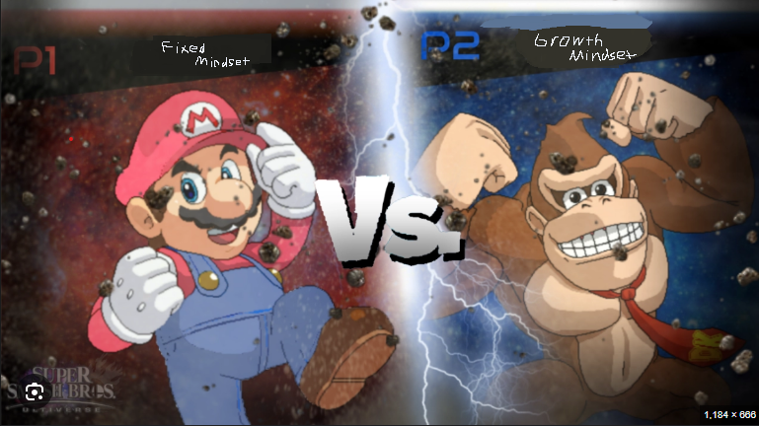

Slide 5
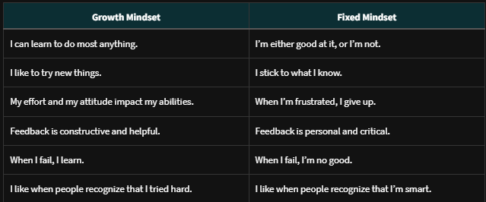

Slide 6
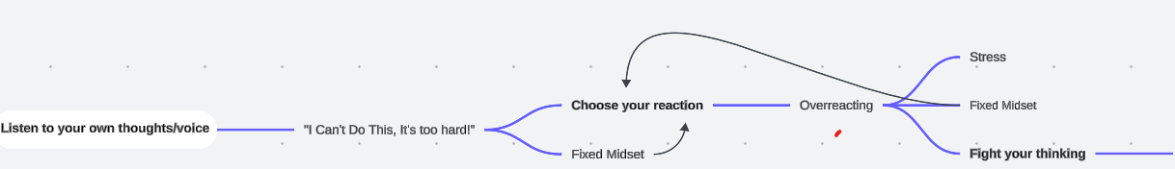
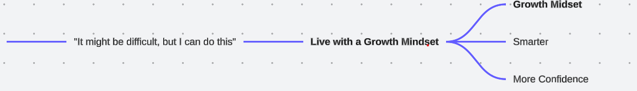

Slide 7
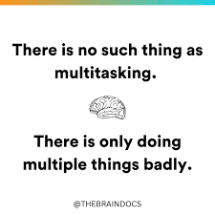

Slide 8

Distractions

Slide 9
Doomscrolling

